Slide 1
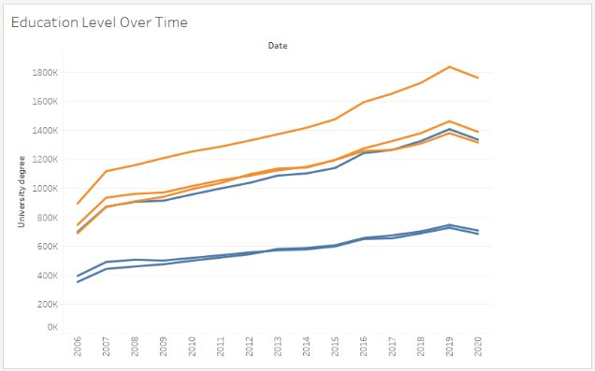
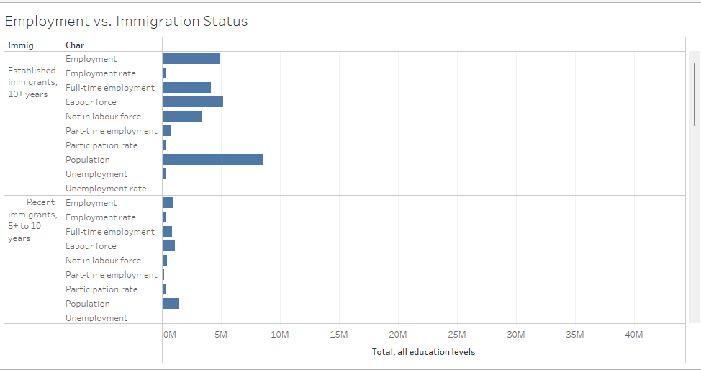
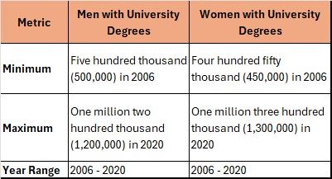
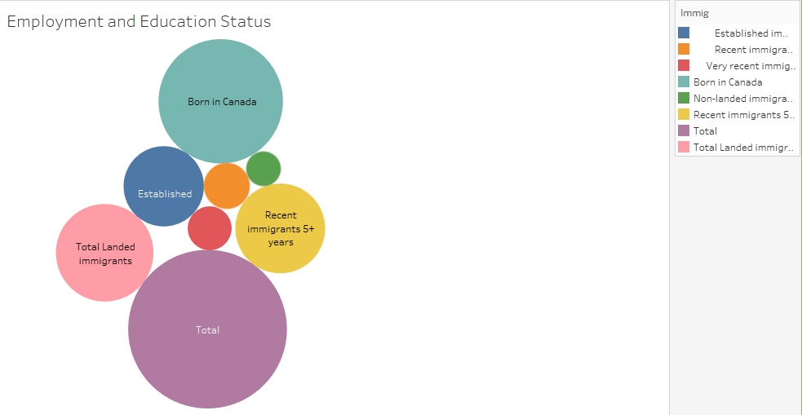
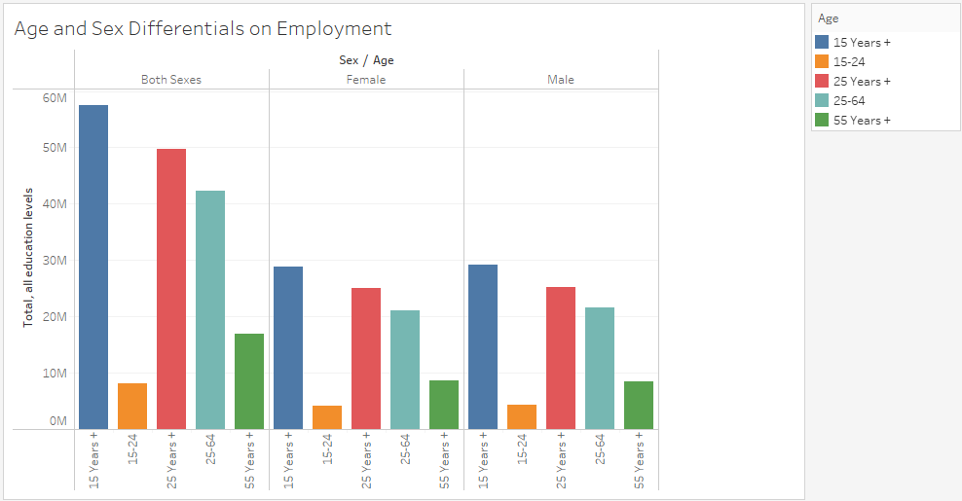
Immigration, Education, and Ontario Labor Force Employment
Soundarya Gurram, Rachana
Business Process Flow 2 – QUAL8381-24F- Sec5
ABSTRACT
MATERIALS & METHODS
RESULTS
CONCLUSIONS
Immigration is essential to Ontario’s workforce because immigrants contribute skills, labor, and innovation. They help address workforce shortages and support economic growth.
The data used in this study includes various groups like recent immigrants, established immigrants, and non-immigrants (those born in Canada). It covers:
Employment Status: Who is employed, unemployed, or out of the labor force.
Education Levels: Ranging from no formal education to university degrees.
Demographics: Age groups (15-24, 25-54, 55+) and sex (male, female).
The study aims to understand how different factors (like immigration status, education, age, and gender) affect employment in Ontario. This information can guide policies to help immigrants integrate and succeed in the workforce.
Data Source:
The data is obtained from the Labour Force Survey by Statistics Canada and the Open Government Portal (Labour Force Characteristics by Immigrant Status, Annual).
Sample Size:
Data includes a broad sample representing Ontario's immigrant and non-immigrant population across various age groups and education levels.
Methods:
Data Analysis: line chart displays the trends in university degree attainment over time from 2006 to 2020. It shows a general upward trend, with university degrees increasing significantly until around 2019, after which there is a slight decline. The different lines likely represent various demographics or age groups, with higher lines indicating larger numbers of individuals with university degrees. Overall, the chart suggests a growing educational attainment in university degrees over this period. The
This table presents the minimum and maximum counts of men and women with university degrees over a selected period (2006 to 2020).
Men with University Degrees:
Minimum: The lowest recorded number of men with university degrees was 500,000 in 2006.
Maximum: The highest recorded number was 1,200,000 in 2020.
Year Range: Data spans from 2006 to 2020.
Women with University Degrees:
Minimum: The lowest count of women with university degrees was 450,000 in 2006.
Maximum: The highest was 1,300,000 in 2020.
Year Range: Data also spans from 2006 to 2020.
This table highlights the increasing trend in university attainment for both men and women over time, with women reaching a slightly higher maximum than men by 2020.
Employment vs. Immigration Status:
Recent immigrants (those who arrived in Canada within the past few years) generally have a harder time finding jobs compared to immigrants who have been in Canada for a long time and compared to people born in Canada. This is often due to challenges such as language barriers, difficulties in getting foreign credentials recognized, and a lack of Canadian work experience.
Trend: Over time, as immigrants settle in, improve their language skills, build local networks, and gain Canadian experience, their chances of getting a job improve. Eventually, long-term immigrants (established immigrants) have employment rates that are close to or even equal to those of non-immigrants.
2. Employment and Education:
Across all groups (recent immigrants, established immigrants, and non-immigrants), people with higher education levels, especially those with university degrees, have much better job prospects. This is because a higher education level often makes someone more qualified for various jobs and can provide specialized skills that are in demand.
Key Insight: Education acts as a strong advantage in the job market. People without formal education or with only basic schooling have a tougher time finding jobs, whereas those with post-secondary education or a university degree are more likely to be employed. This suggests that education is a key factor for job success, regardless of immigration status.
3. Age and Gender Employment Differences:
Employment rates are highest for people in the 25-54 age range, often considered the "prime working age." Younger people (ages 15-24) may have lower employment rates as many are still in school, while older people (55+) may face retirement or health-related limitations that affect their ability to work.
Gender Differences: Men tend to have higher employment rates than women across all groups. This difference is even more noticeable among immigrants. There are several reasons for this gap:
Caregiving: Women often take on more caregiving responsibilities, which can limit their availability for work.
Cultural Expectations: In some immigrant communities, cultural expectations may influence women’s participation in the workforce.
Systemic Barriers: Women, particularly immigrant women, may face challenges like discrimination or lack of support (e.g., affordable childcare), which affects their employment.
Duration Since Immigration:
Immigrants who have been in Canada for a longer time have a better chance of being employed compared to those who recently arrived. This is because over time, immigrants can improve their language skills, understand the Canadian job market, build local networks, and gain Canadian work experience. As a result, immigrants who have lived in Canada for many years (established immigrants) often have employment rates similar to people born in Canada (non-immigrants).
Education:
Having a higher level of education, especially a university degree, greatly improves a person’s chances of getting a job. This is true for everyone, whether they are immigrants or non-immigrants. Education helps people develop specialized skills and knowledge that are in demand in the job market. People without formal education or only basic schooling usually find it more challenging to get a job. This finding highlights the importance of educational attainment for successful employment.
Gender Disparities:
Women, particularly immigrant women, have lower employment rates compared to men. This difference is partly due to caregiving responsibilities, as women are often more involved in taking care of children or family members, which can limit their ability to work. Additionally, cultural expectations and systemic barriers may affect immigrant women more than men, making it harder for them to join the workforce. Addressing these gender disparities can help increase employment opportunities for women, especially those who are immigrants.
OBJECTIVES
List of Specific goals of the analysis.
Employment Rates by Immigration Status: Determine if being a recent or established immigrant affects the likelihood of being employed.
2.Impact of Education on Employment: Examine how having higher education, such as a university degree, affects job opportunities for immigrants and non-immigrants.
3. Age and Gender Employment Differences:
Analyze how age groups and gender influence employment, especially among immigrants.
REFERENCES
Government of Canada. (n.d.). Labour force characteristics by immigrant status, annual. Open Government Portal. Retrieved from https://open.canada.ca/data/en/dataset/cfb5fdfe-e491-4b23-80fa-401c0deb33c4/resource/d4b0920a-72fb-443e-90eb-1bbee2333d00
Data Source: https://open.canada.ca/en
Template: Powerpoint poster templates for research poster presentations
Zoom Recording Link: https://conestogac.zoom.us/rec/share/5z869rFus5GH6DVaAStyP-MwQh9if3lbavL7e3QD8kkdDpTw3OPrCz_F9pJqCvUf.2V9uuf7tDZrweb16?startTime=1731377195000

